Slide 1
Bayesian inference
Dave Kleinschmidt // Cognitive Psychology & RuCCS
Deeper data analysis // 26 Feb 2020
Notes:
Hello! I'm a new assistant professor in psychology. My intersets cut a pretty wide swath across RuCCS so I'm hoping to give you a sense of what I'm interested in, what I'm working on now, and the kinds of problems I'm intersted in collaborating on in the future.
broadly work on perception: information about the world via sensory signals. in particular, challenges that variability poses, especially across contexts, and the opportunities that structure in that variability provides for brains that can effectively take advantage of that structure.
broad approach: rational analysis, computational level. what's the goal? what's the information available in the world? what are the inductive biases? in Marr's tradition, best work is integrative across levels.

Slide 2
The plan
Frequentist vs. Bayesian probability
Generative modeling
Working with samples

Slide 3

The t test
Take your data x, and calculate the observed mean (sum of x / number of data points)
Divide the observed mean by the sample standard deviation to get the t statistic
Look up the p value in a table/using SPSS/R/whatever.

Slide 4
Think...
What is a probability (e.g. a p value)?
Take for example a two-tailed t test, where p = 0.02
What does that p value mean?
What can you infer about the process that generated your data, based on this test?

Slide 5
Frequentist probability
Frequentists define probability as the long-run frequency of an event under replication of a random process
Frequentist probability is only ever associated with data, never with hypotheses or parameters

Slide 6
The t test (again)
The (true) mean of the data-generating process is unknown and unknowable
It is a parameter that exists only in the mind of God
The reason we do statistics is to gain some kind of information about that parameter

Slide 7
The t test (again)
Why do you divide the sample mean by the standard deviation?
Why do you calculate the sample mean at all??
What does the sample mean have to do with the actual, true, known-only-to-God mean?

Slide 8
Frequentist probability
Is counterfactual:
Imagine that the true mean is actually 0.
What distribution of sample means would you get under this zero-mean process?
If observed mean is sufficiently different from these simulated means, we reject the null hypothesis of mean = 0.

Slide 9
Frequentist probability
What does this procedure tell you about the actual sample mean?
The p value is a statement about how likely the data is given a hypothesis:
p(data | mean=0)
(read this as “probability of the data given that the mean is 0”).

Slide 10
Frequentist probability
Why can’t we just “turn this around” and talk about p(mean | data)??
(We can, mathematically; stay tuned)
Frequentists insist that parameters like mean have a single, true value (known to God), and therefore it is nonsensical to talk about probabilities of other values

Slide 11
Frequentist probability
Frequentist statistics is the way it is because of an interpretation of probability itself
There are other possible interpretations!

Slide 12
Bayesian probability
Who’s heard of “Bayes’ theorem/rule”?
p(H | D) = p(D | H) p(H) / p(D)
H = “hypothesis”, D = “data”
Not a major insight or theorem, rather a reinterpretation of what probability means

Slide 13
Bayesian probability
Basic axiom of conditional probability:
p(A, B) = p(A | B) p(B)
p(A, B) = p(B | A) p(A)
Example
B = “wearing a coat?”, A = “raining?”
so...
p(A | B) p(B) = p(B | A) p(A)
p(A | B) = p(B | A) p(A) / p(B)

Slide 14
Conditional probability
Exercise: Monty Hall problem.
Three doors, one has a car, two have goats.
You pick one door, and then the host opens one of the other two to reveal a goat. Should you switch?
What are the hypotheses?
What is p(H) for each hypothesis?
What is the data?
What is p(D | H) for each hypothesis?

Slide 15
Bayesian probability
The basic “move” of Bayesian statistics is to say that we should think of probability as a measure of degree of belief that we can apply to parameters and hypotheses
(Instead of the frequentist interpretation as long-run frequency of repeatable events)

Slide 16
Bayesian probability
Bayesian statistics “reads” the axiom of conditional probability differently:
p(H | D) = p(D | H) p(H) / p(D)
updated
(posterior)
belief in H
how well
H predicts
data D
times our
prior belief
in H
normalized
by how
likely the data
was overall

Slide 17
The t test (again (again))
A “Bayesian t-test” goes straight for the jugular: what is p(mean | data)?
Note: “mean” is the parameter. When we write p(mean | data), that’s shorthand for p(mean=x | data), which is a function of they hypothetical value mean=x
Apply Bayes rule:
p(mean | data) = p(data | mean) p(mean) / p(data)

Slide 18
The t test (again (again))
We want to infer the mean of the data-generating process
What is this process? Specified via generative model
The generative model is your data's origin story
Two parts: prior and likelihood

Slide 19
Likelihood: p(D | H)
Given values of our parameters, how did our data come about?
For the t test, the parameters are a mean and a variance
Given mean and variance, the data points are drawn from a Normal distribution.
These are assumptions of the model!!

Slide 20

Prior p(H)
Where did the parameters come from?

Slide 21
Prior: p(H)
Where did the parameters come from?
We need a story for this, which captures our uncertain beliefs about these parameters before observing any data
In practice, this doesn't matter as much as the likelihood, since the data tend to overwhelm the prior most of the time

Slide 22
Prior: p(H)
A convenient choice when we have Normally distributed data:
Variance is drawn from an “Inverse Chi-squared” distribution
Mean from a Normal distribution itself.
We have to pick the parameters of THESE distributions too!
What is a reasonable prior guess for the mean? Zero? How confident are we?

Slide 23
Posterior: p(H | D)
Now we can combine prior and likelihood, given some data, using Bayes rule!

Slide 24
Posterior: p(H | D)
Unfortunately it's not generally so Easy™ to figure out p(H | D)
Bayesian modeling provides a lot of flexibility, but at the cost of more involved computations
For certain combinations of prior and likelihood, we can write down in algebraic forms what the posterior is...

Slide 25
(notebook)

Slide 26
Using samples instead
Working directly with the posterior p(H | D) is generally very hard.
It's often easier to work with samples, a finite set of discrete hypotheses that represent the distribution

Slide 27
Hypotheses
(prior)
probability
high
low
Data
Notes:
I think it's actually easier to think about how this works when we have a sample from our prior distribution over parameters...an approximation of our prior distribution using a randomly chosen set of “representative values”

Slide 28
Hypotheses
(prior)
probability
high
low
Data

Slide 29
Hypotheses
(prior)
probability
high
low
Data

Slide 30
Hypotheses
(prior)
probability
high
low
Data

Slide 31
Hypotheses
(updated)
probability
high
low
Data

Slide 32
Hypotheses
(updated)
probability
high
low
Data

Slide 33
Hypotheses
(updated)
probability
high
low
Data

Slide 34
Hypotheses
(updated)
probability
high
low
Data

Slide 35
Hypotheses
(updated)
probability
high
low
Data

Slide 36
Hypotheses
(updated)
probability
high
low
Data

Slide 37
Hypotheses
(updated)
probability
high
low
Data

Slide 38
What good is p(H | D)?
Once you can calculate e.g. p(mean = x | data), you can do all kinds of useful things.
You can use conditional probability to “ask questions” of the posterior:
p(mean > 0) = ∫ p(x>0|mean=x)p(mean=x|data) dmean
(or, count the fraction of sampled values for mean greater than zero)

Slide 39
Assumptions: p(H|D,model)
Inferences all depend implicitly on the choices you make
Choice of prior
Choice of generative model
Inferences are only valid as long as those assumptions are true
They never are
But in practice often close enough
Important to check your assumptions!

Slide 40
Generative modeling
An example from my own past...
Zaki and Kleinschmidt (2014, Memory and Cognition)

Slide 41
Dealing with people who will not learn
Dave Kleinschmidt
BST 413 // May 1, 2013

Slide 42
Background
How do task and training interact in learning?

Slide 43
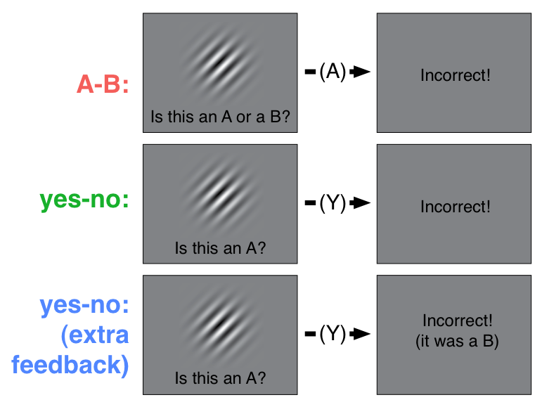
Training

Slide 44
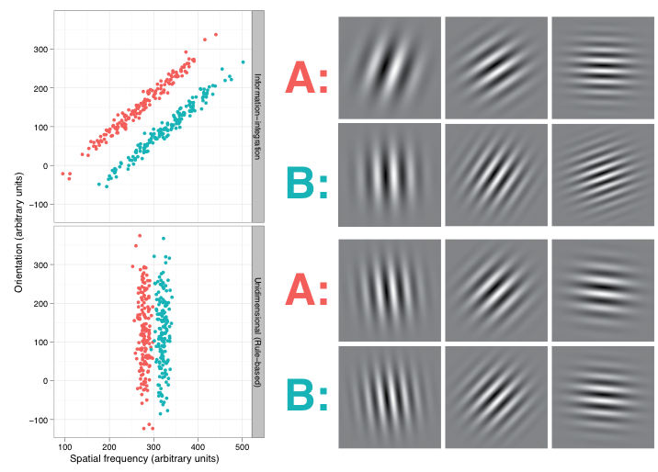
Tasks
II
RB

Slide 45
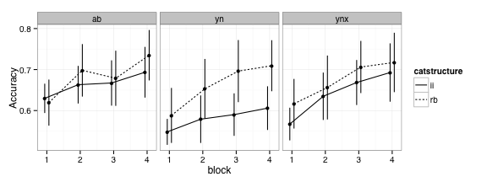
Data
Notes:
What we’re interested in is how well and how quickly people learn in these different conditions. In particular, we’d like to be able to say which of these combinations of conditions produce better learning, which is commonly done in this field using ANOVA or other regression-based techniques.

Slide 46
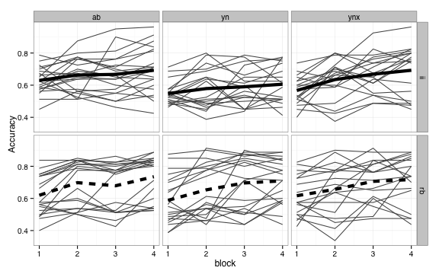
Notes:
Now typically, the standard ANOVA analysis assumes that the data are normally distributed, but clearly they are not normally distributed here. There seems to be a large number of subjects who simply to not show any learning, performing at chance accuracy throughout.

Slide 47
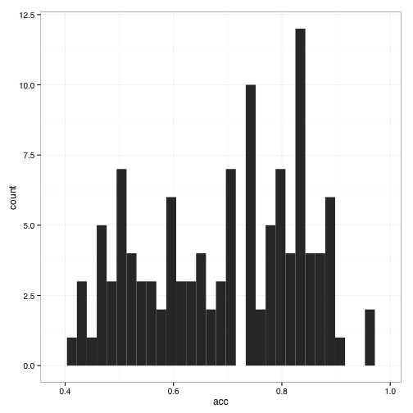
Notes:
If we look at the overall distribution of final-block accuracy, it’s highly bimodal.

Slide 48
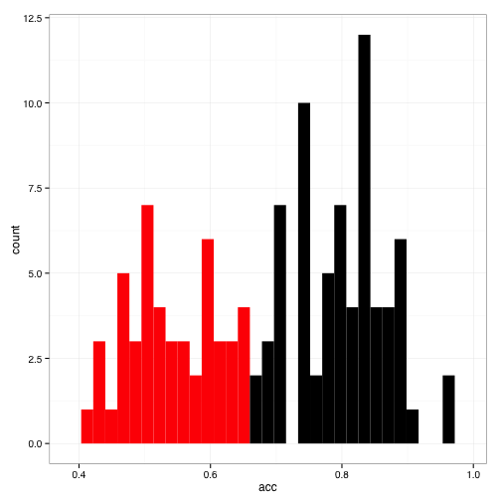
Notes:
Some people in this field have suggested throwing out data from subjects with accuracies below 65%. This pretty cleanly splits the two groups, but there are some problems.

Slide 49
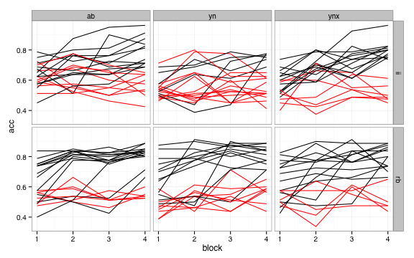
Notes:
Most notably, in some conditions, you’d be throwing out nearly all the subjects, and in many cases there isn’t a clear bimodality between learners and non-learners. Also, this approach ignores the fact that some conditions might produce more non-learners than others, which is as theoretically interesting as how well people learn when they catch on.

Slide 50
Questions
What are the effects of experimental conditions on who learns?
On how well/fast they learn?
Notes:
There’s uncertainty about both of these issues, given limited and noisy data, so a bayesian approach is well suited to this problem.

Slide 51
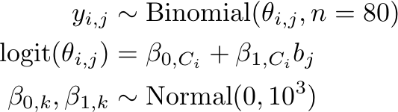
LEARNING CURVE MODEL: BAYESIAN LOGISTIC REGRESSION
Notes:
The second question is modeled using a straightforward logistic regression model, where the number of successful trials (out of 80) in block j for subject i are modeled as a…

Slide 52
FIT USING GIBBS SAMPLING (JAGS/BUGS)
model {
for (c in 1:Ncond) {
intercept[c] ~ dnorm(0, 1e-3)
slope[c] ~ dnorm(0, 1e-3)
for (block in 1:Nblock) {
logit(theta[block, c]) <- intercept[c] + slope[c] * (block - Nblock/2 - 0.5)
}
}
for (subj in 1:Nsubj) {
for (block in 1:Nblock) {
y[subj, block] ~ dbinom(theta[block, cond[subj]], n[subj, block])
}
}
}
Notes:
Using the JAGS package inference in this model is done very simply using Gibbs sampling. 3 chains, 1000 samples each, checked convergence via Rhat

Slide 53
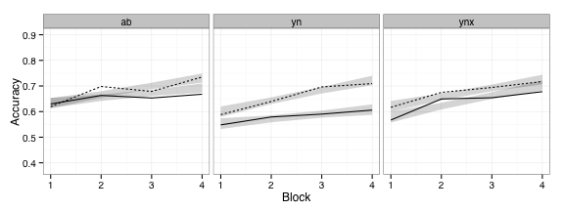
Logistic regression fits
Notes:
Here are the learning curves, with the 95% posterior predictive intervals from the logistic regression

Slide 54
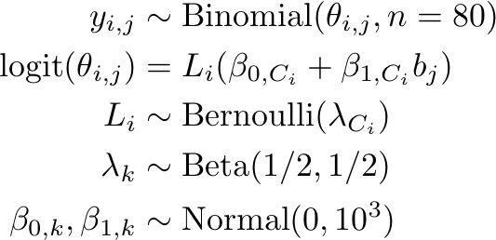
Modeling Non-learners
Notes:
How

Slide 55
FIT USING GIBBS SAMPLING (JAGS/BUGS)
model {
for (c in 1:Ncond) {
# regression parameters
intercept[c] ~ dnorm(0, 1e-3)
slope[c] ~ dnorm(0, 1e-3)
for (block in 1:Nblock) {
logit(theta[block, c]) <- intercept[c] + slope[c] * (block - Nblock/2 - 0.5)
}
# learner rate
learnerRate[c] ~ dbeta(0.5, 0.5)
}
for (subj in 1:Nsubj) {
# sample non-learner index
Learner[subj] ~ dbern(learnerRate[cond[subj]])
for (block in 1:Nblock) {
x[subj, block] ~ dbinom(theta[block, cond[subj]] * Learner[subj] +
0.5 * (1-Learner[subj]),
n[subj, block])
}
}
}

Slide 56
Logistic regression fits

Slide 57
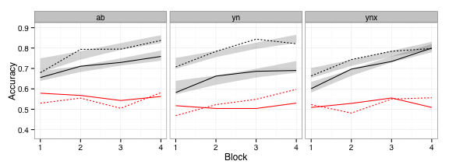
Logistic regression + non-learners fits

Slide 58
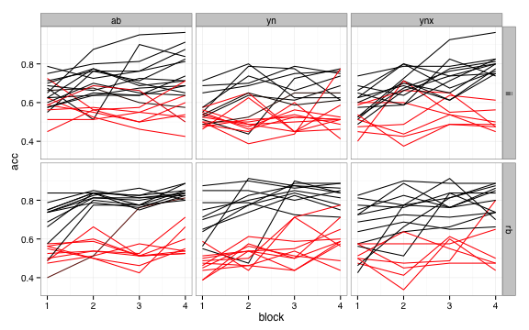
Notes:
Here are the individual subjects data, color coded according to the probability they are classified as a learner. Looks pretty similar to what we saw before with the 65% cutoff, with some important exceptions

Slide 59
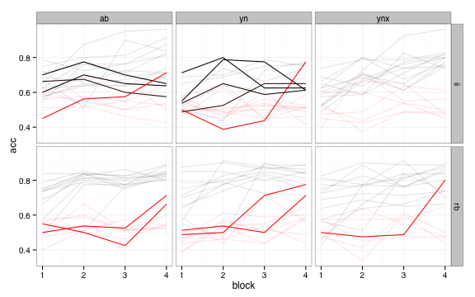
Notes:
Note that there are BOTH kinds of disagreements: subjects in conditions where learning is generally poor are classified as learners even though they have low final block accuracies. More problematically, subjects who have high final block accuracies but low otherwise are classified by this model as non-learners.

Slide 60
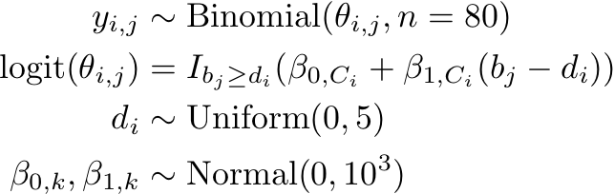
Modeling delayed learners
Notes:
Can refine the model by using a learning DELAY instead of a simple binary classification. The delay goes from 0 to 5; anything over 4 is the same as a non-learner in the last model

Slide 61
FIT USING GIBBS SAMPLING (JAGS/BUGS)
model {
for (c in 1:Ncond) {
# regression parameters
intercept[c] ~ dnorm(0, 1e-3)
slope[c] ~ dnorm(0, 1e-3)
}
for (subj in 1:Nsubj) {
delay[subj] ~ dunif(0, Nblock+1)
for (block in 1:Nblock) {
logit(theta[subj, block]) <- (intercept[cond[subj]] +
slope[cond[subj]] *
(block-Nblock/2-0.5-delay[subj])
) * (block > delay[subj])
# sample succeses
y[subj, block] ~ dbinom(theta[subj, block], n[subj, block])
}
}
}

Slide 62
Logistic regression + non-learners fits

Slide 63
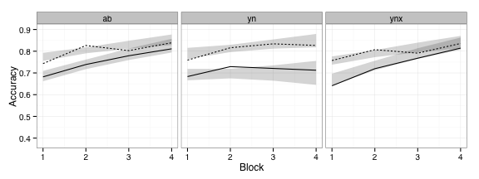
Logistic regression + Delayed learners fits
Notes:
Here’s the results from the delayed learner fits, plotted with data from people who were classified as starting learning in the first block. Note that the overall accuracy for learners goes up, and the slopes flatten out a bit. This suggests that what would have been interpreted as gradual learning might really be due to the fact that people jump from chance to relatively high accuracy rather abruptly.

Slide 64
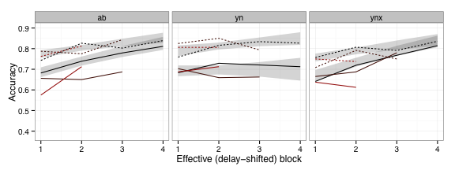
Logistic regression + Delayed learners fits
Notes:
Grouped by (rounded) delay and plotted with the shifted block (b_j – d_i)

Slide 65
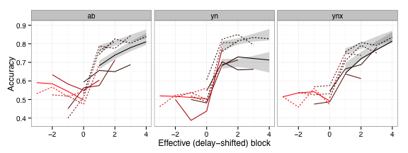
Logistic regression + Delayed learners fits
Notes:
And here’s the same plot showing the non-learning blocks, too. You can see that in most cases there’s a pretty sharp increase in accuracy once learning is said to begin by the model.

Slide 66
Conclusions: learning curves
Bayesian data analysis provides flexible tools for understanding behavioral data
Capture effects of non-learners in a sensible way

Slide 67
Conclusions: overall
Bayesian and frequentist stats are different philosophies about probability
Frequentist: long-run frequency of event
Bayesian: degree of belief
Bayesian approaches to data provide:
more flexibility
intuitive inferences
more “footguns”

Slide 68
Conclusions: overall
Don't throw out frequentist approaches!
Sometimes we care about the long-run frequency of events
How many false-positive results would we get from a particular way of designing and analyzing studies?
More restrictive assumptions = long history of looking at the consequences of when they fail

